Slide 1
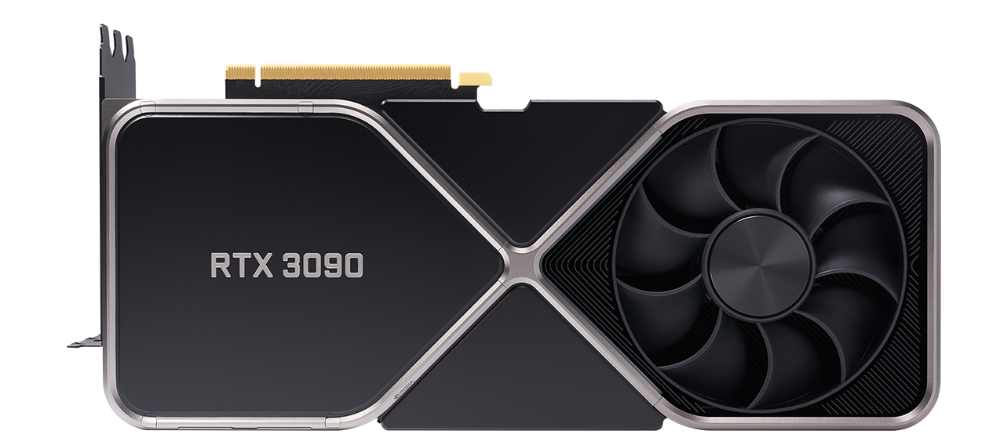
Graphics Processing Unit
GPU

Slide 2
01
Early History of Graphics Cards

Slide 3
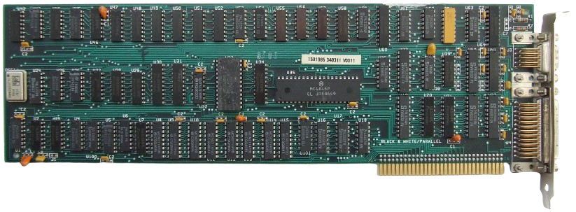
IBM MDA
1981
Monochrome Display Adapter
Text Only
80x25 Characters
First dedicated PC display card

Slide 4
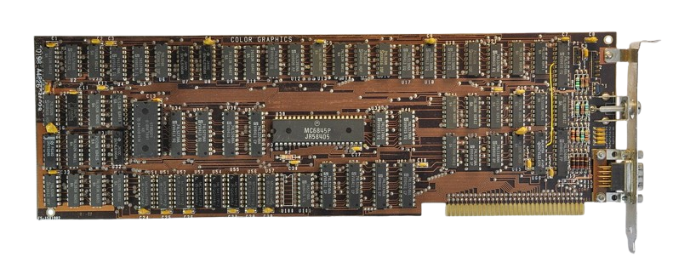
IBM CGA
1981
Color Graphics Adapter
Up to 16 colors
First consumer color graphics card

Slide 5
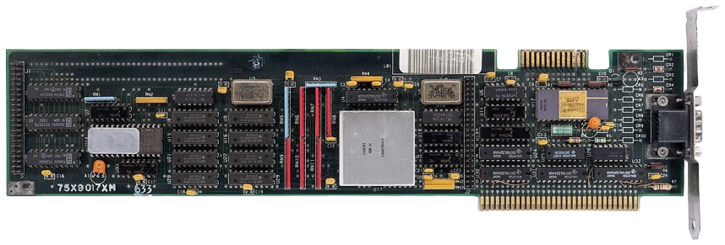
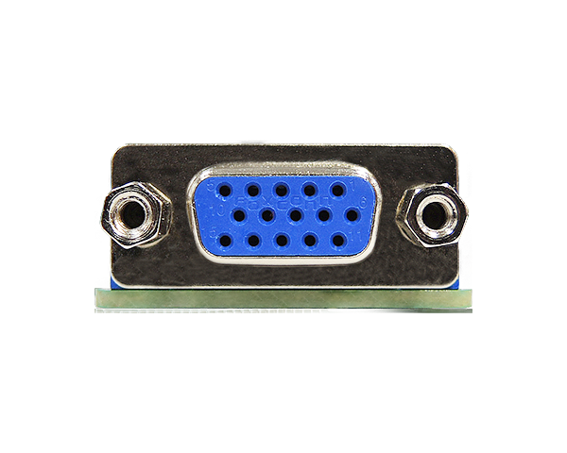
IBM VGA
1987
Video Graphics Array
640×480 resolution
256 colors
VAG Became the standard for many years

Slide 6
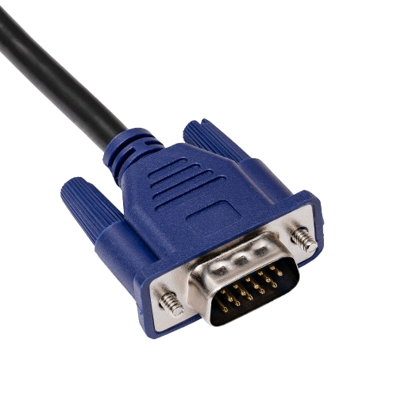
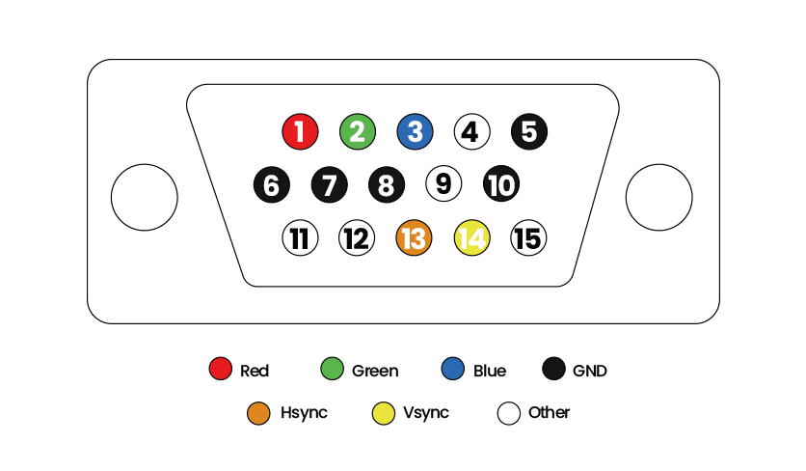
VGA
Type: Analog signal
Connector: 15-pin

Slide 7
02
The Beginning of 3D Graphics

Slide 8
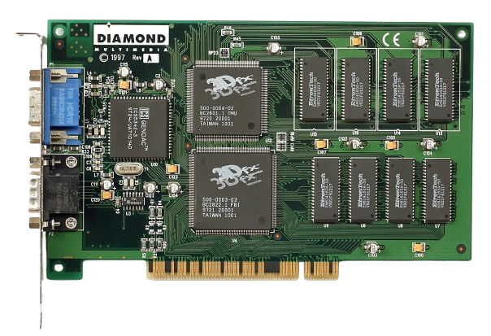
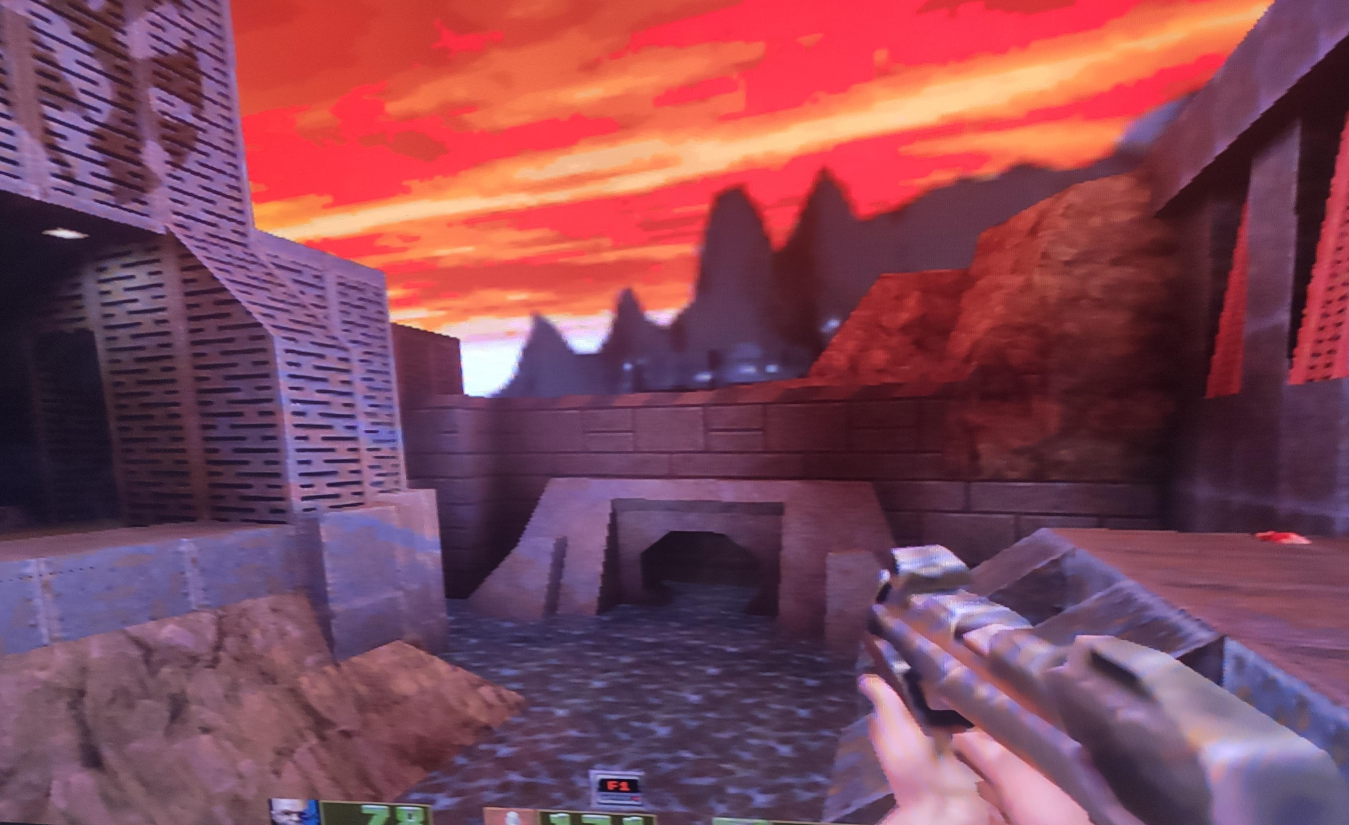
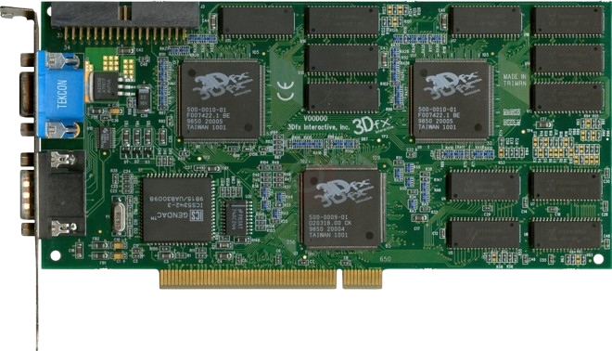
3dfx Voodoo 1&2
1996 & 1998
quake2
Dedicated 3D accelerator cards
SLI 1998

Slide 9
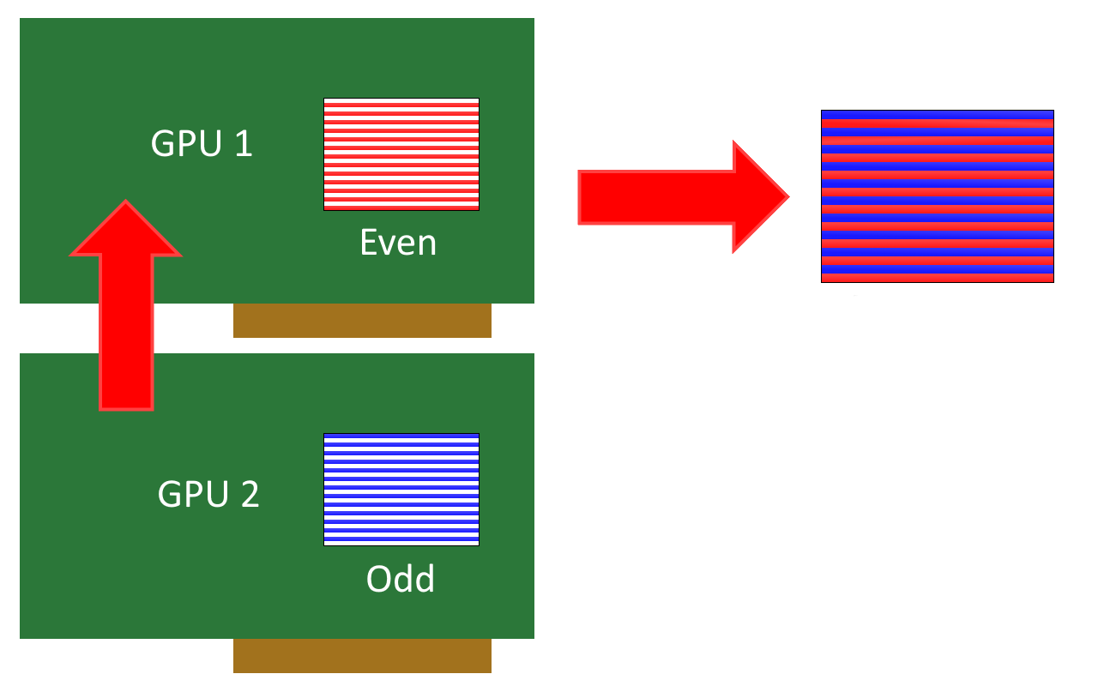
3dfx SLI
1998
Scan
Line Interleave

Slide 10
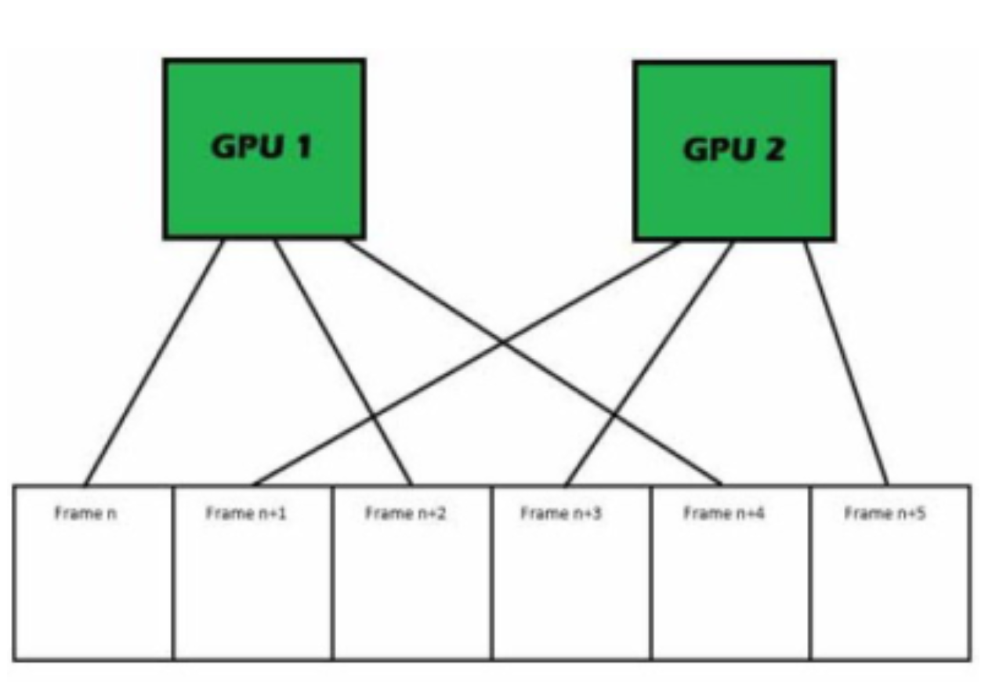
NVIDIA SLI & AMD CrossFire
2004 & 2005
Scan
Line Interleave

Slide 11
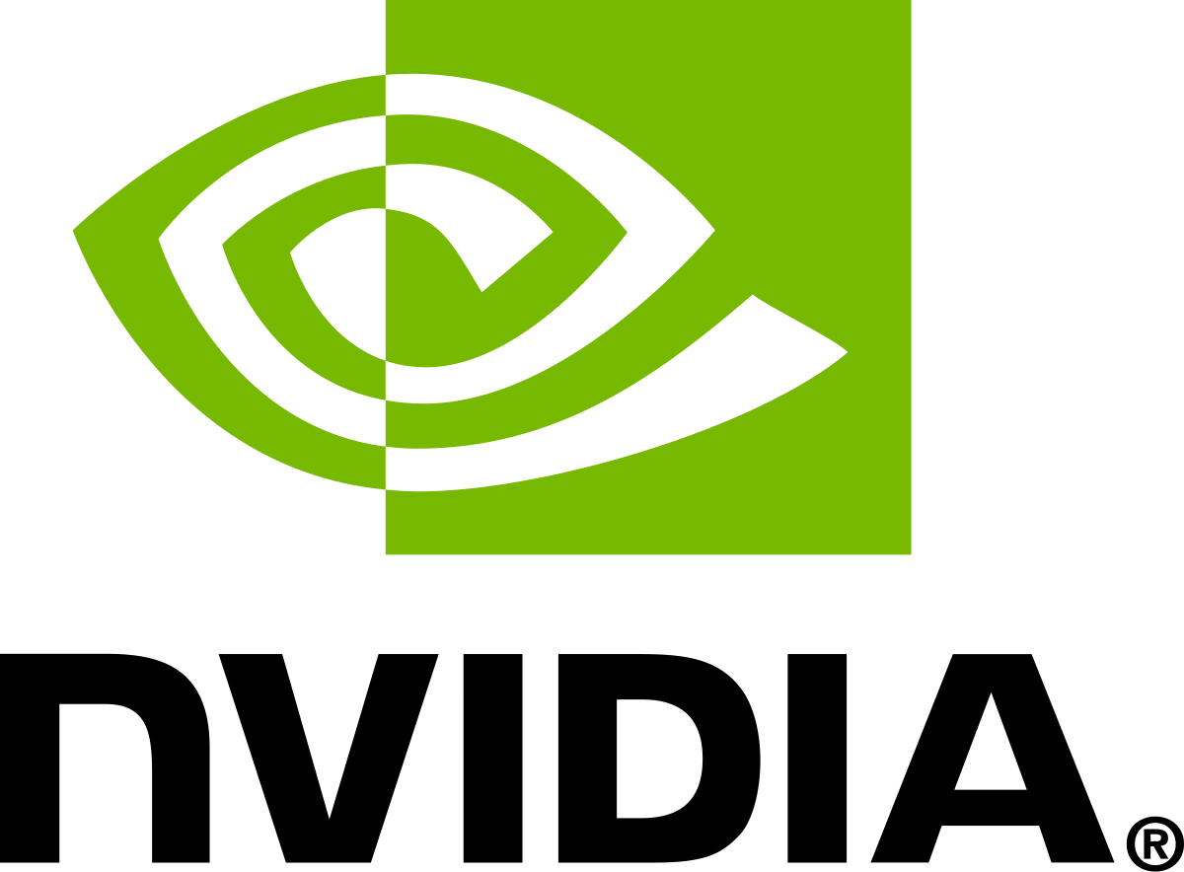

3dfx Rise and Fall
1994-2000
Dominant in PC gaming graphics
Financial decline after failed product strategies
NVIDIA purchased 3dfx in 2000 for 70 million USD
70.000.000$

Slide 12
03
The GPU Revolution

Slide 13
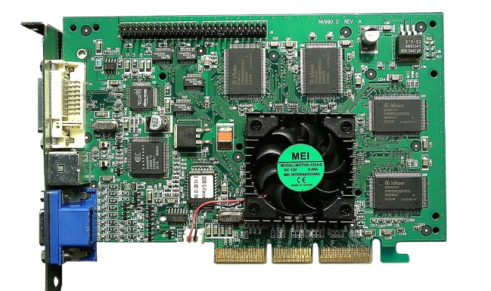
NVIDIA GeForce 256
1999
Marketed as the “first GPU”
First card with hardware Transform & Lighting (T&L)
Accelerated growth of PC gaming

Slide 14
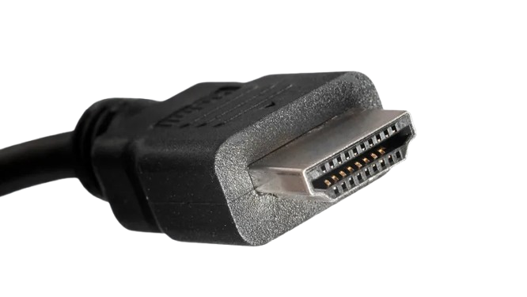
HDMI
2000
High Definition Multimedia Interface
Single cable for audio + video
Became the standard interface

Slide 15
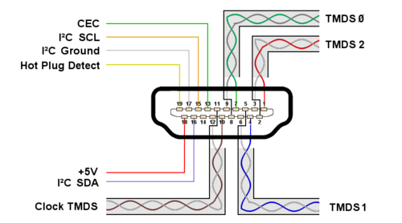
HDMI
Type: Digital signal
Connector: HDMI type A
Transition-Minimized
Less Transitions
Differential Signaling
2 Lines
1 Normal
1 Inverted

Slide 16
04
The Major GPU Companies

Slide 17

The Three Big Players (1990s–2000s)
Early 3D acceleration
High-end performance focus
Strong mainstream and Radeon brand

Slide 18
ATI Technologies
1985
Canadian GPU manufacturer
Known for the Radeon series (since 2000)
Major competitor to NVIDIA in early 2000s
Good price-performance ratio
Notes:
1985

Slide 19

AMD Acquisition of ATI
2006
Radeon becomes AMD’s graphics division
Led to development of APUs (CPU + GPU)
70.000.000$
5.600.000.000$

Slide 20

AMD Driver Issues
2015
Stability issues & performance inconsistencies
Caused damage to brand reputation

Slide 21
AMD Driver Issues
2015
Stability issues & performance inconsistencies
Caused damage to brand reputation

Slide 22
05
Modern GPU Technologies

Slide 23
CUDA NVIDIA
2006
Compute Unified Device Architecture
Made GPUs programmable for general-purpose tasks
Major reason for NVIDIA’s dominance in AI today
Foundation for AI, Machine Learning, Scientific simulations and Video processing

Slide 24
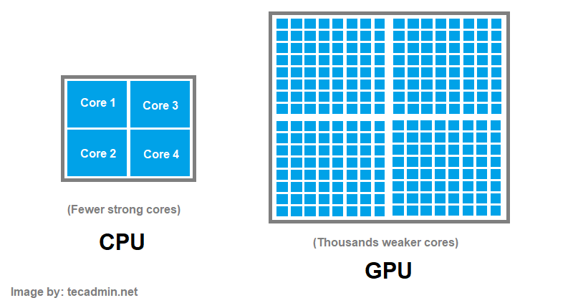
Parallel Processing

Slide 25
DLSS
2019
Deep Learning Super Sampling
AI upscales low-resolution images to high resolution
Higher FPS
AI reconstruction errors

Slide 26
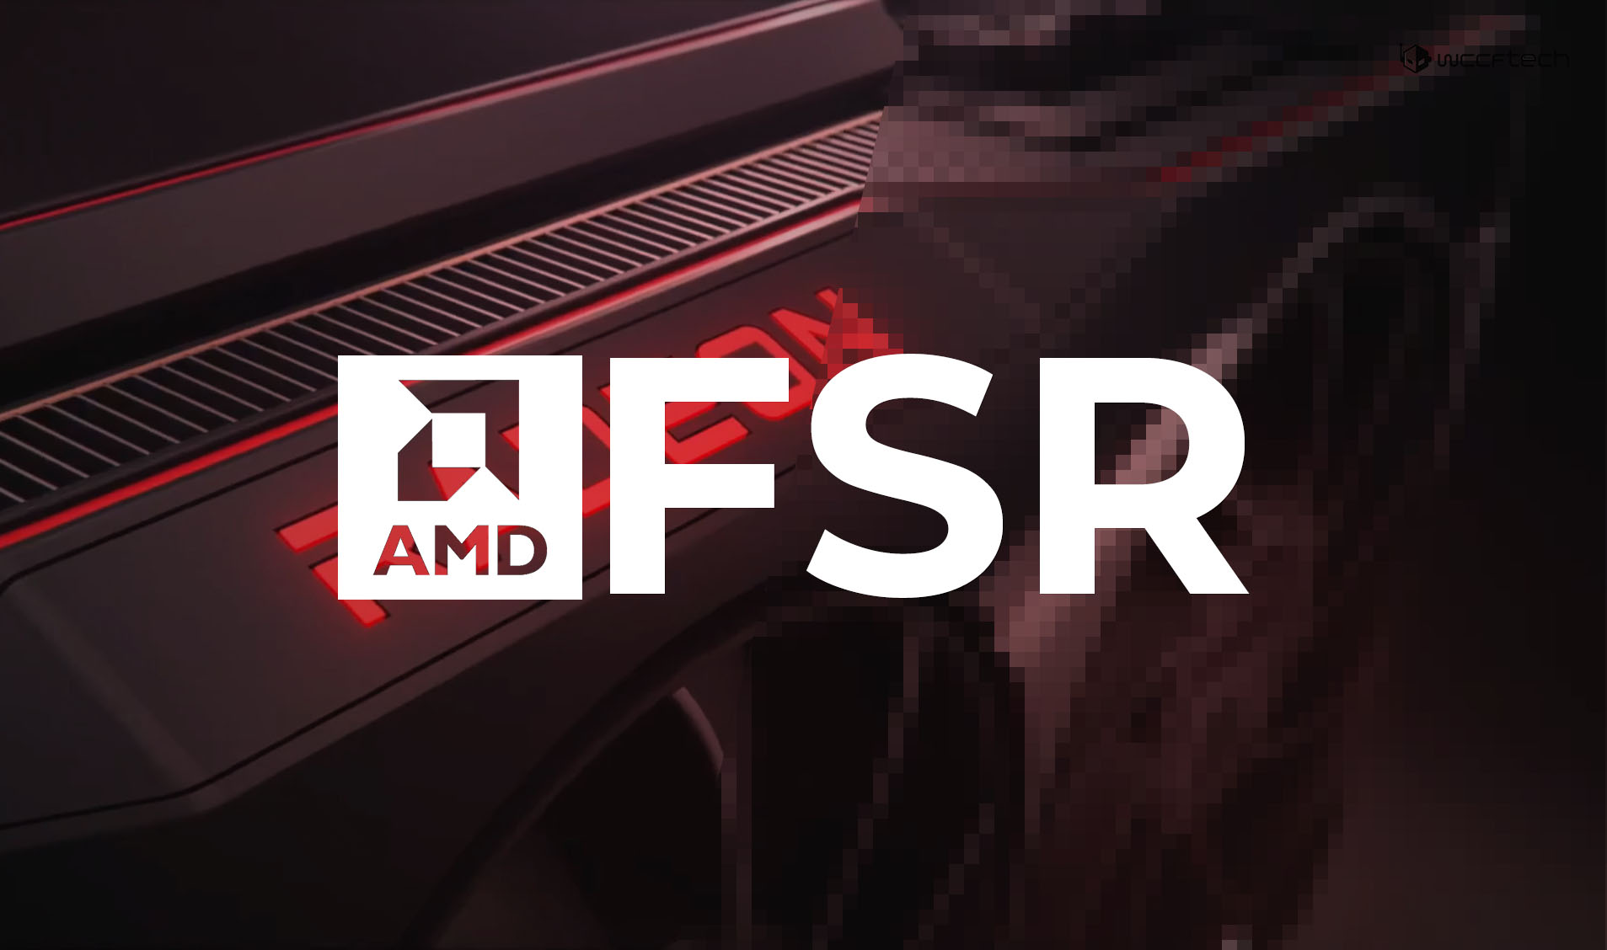
AMD FSR
2021
FidelityFX Super Resolution
Open-source alternative to DLSS

Slide 27
06
How Does It Work

Slide 28
How a Final Image Is Created
The Game Engine Sends Scene Data
Models
Textures
Geometry Processing
Processes 3D Objects
Vertex Shading
Perspective
Rasterization (3D → 2D)
Triangles are broken into pixels
Pixel Shading
Every pixel gets its final look
Output Merger (ROP Stage)
All processed pixels are combined into a single frame
Display Transmission
GPU sends final frame to the display

Slide 29
Summary
Evolution from simple display adapters to AI supercomputing hardware
Major milestones: 3dfx, NVIDIA, ATI/AMD
Key technologies: CUDA, DLSS
GPUs shaping gaming, AI, and scientific computing

Slide 30
Graphics Processing Unit
GPU
Questions?

